Slide 1

WORLD POPULATION DATA ANALYSIS
Created by – Syed Afaq Ahmed

Slide 2
DATASET OVERVIEW
The dataset is composed of 3 tables, 2 tables sharing the same column structure. Table 1 encompasses data spanning from 2000 to 2049, whereas Table 2 focuses on the period from 2040 to 2099.
The 2 tables described male and female population around the world with their age group and which country they belong to.
Table 3 contained information about countries and which continent they belong, along with country and region codes.

Slide 3
TOOLS USED
Microsoft Power BI, Power Query & DAX

Slide 4
DATA CLEANING
Changed the data types for columns with incorrect data types
Column names were renamed with appropriate names
The Age Group column contained a few rows with months along with age groups. These months were replaced with numbers.
Men and Women population columns were multiplied by 1000 and rounded up.
Removed unwanted columns
Pivoted men and women population columns
The two tables were appended

Slide 5
DATA MODELLING
Once done with cleaning and transformation, I closed and loaded the dataset into the model and created relationship between 3 tables (using one – to many relationship)
FactPopulation as Fact table & DimRegion and DimAge as dimensional tables

Slide 6
DATA ANALYSIS
I analyzed the data and created some DAX measures to enrich my analysis
To analyze the population data, I created several measures. These include the number of countries, the average population, and the population running total.
I created a report using charts and slicers based on the data.

Slide 7
FINDINGS

Slide 8
Population = 943 billion
Number of countries = 194

Slide 9
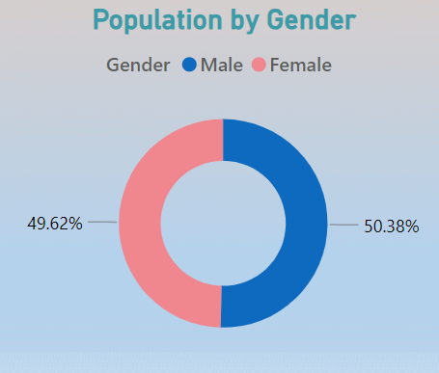
What is the composition of the male and female populations worldwide?
Across the world, the male and female populations are distributed almost equally, with only slight variations.

Slide 10
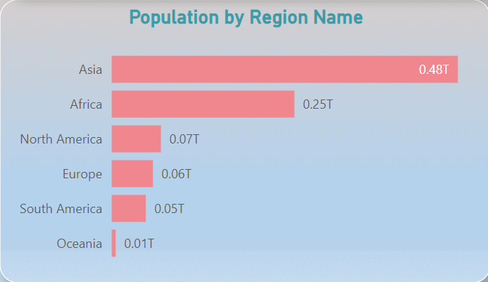
Which region is highly populated?
Among all the regions, Asia is the most populated, followed by Africa in second place, while Oceania is the least populated.

Slide 11
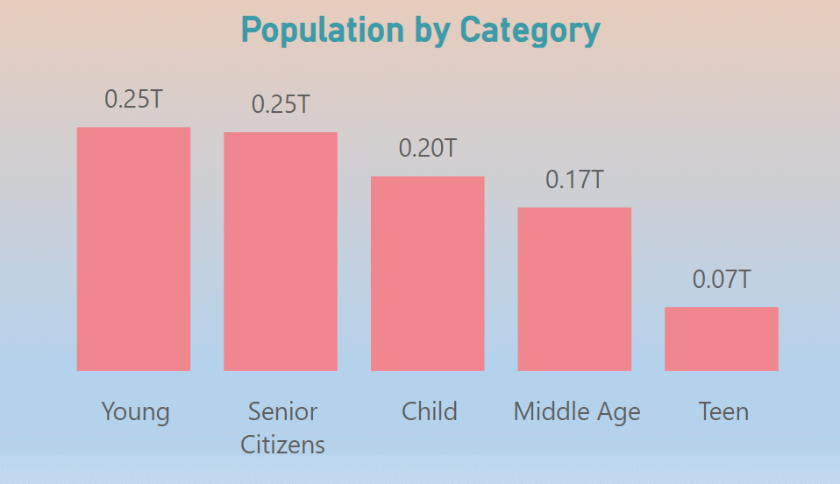
Which age group category has the highest population?
Largest Groups: Young and Senior Citizens are tied as the most populated categories, each accounting for 25% of the total population.
Smallest Group: Teens represent the smallest proportion of the population, making up only 7%.
Middle and Children: Combined, these two groups make up 37% of the population, showing a significant portion in early life and working age.
The population distribution across categories is relatively balanced, with no single group overwhelmingly dominating.

Slide 12
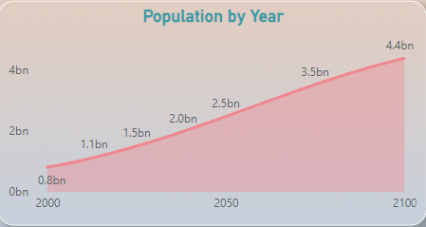
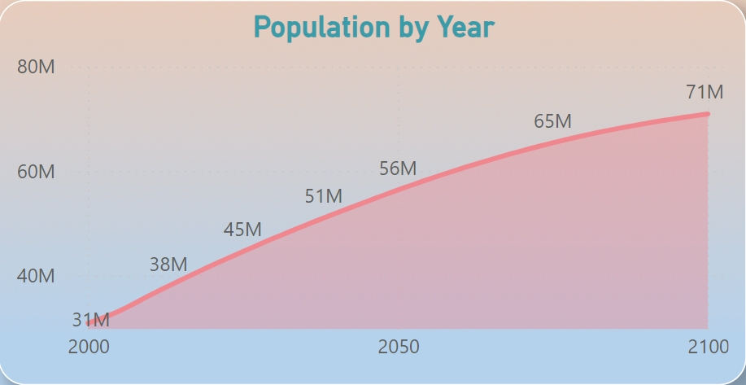
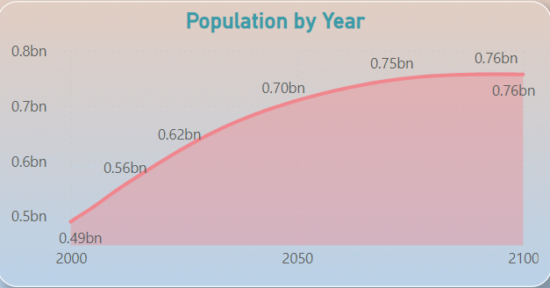
What are the population trends across all regions over the years??
Africa, Oceania and North America shows a steady upward trend in population growth over time. The population begins at a relatively low level and increases consistently, reaching significantly higher levels by the end of the timeline.
Africa
Oceania
North America

Slide 13
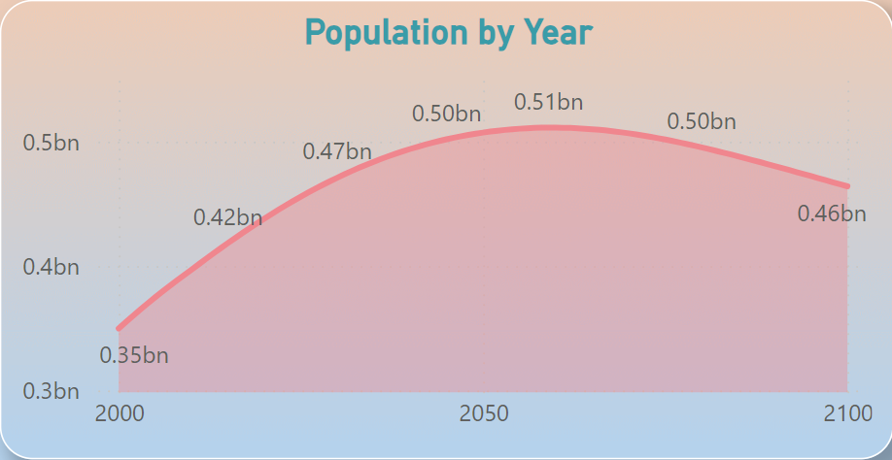
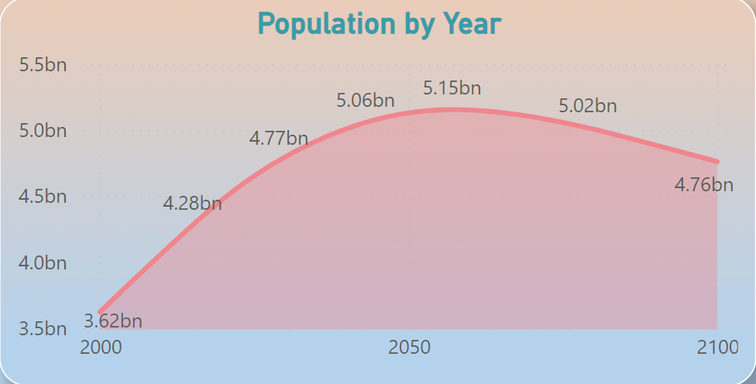
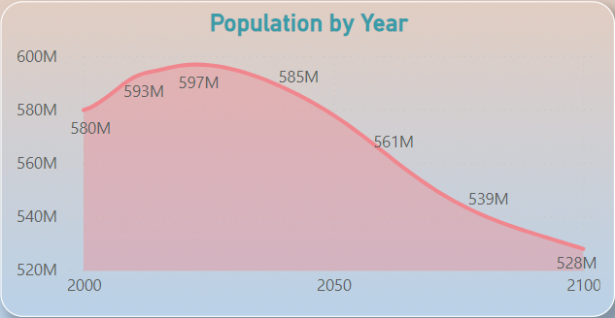
South America and Asia shows a population trend that rises steadily at first, reaching a peak in the middle of the timeline. After the peak, the population begins to decline gradually toward the end of the period.
Europe shows a population trend that starts with a gradual increase, peaking early in the timeline. Following the peak, the population decreases steadily, with the decline becoming more noticeable as time progresses.
South America
Asia
Europe

Slide 14
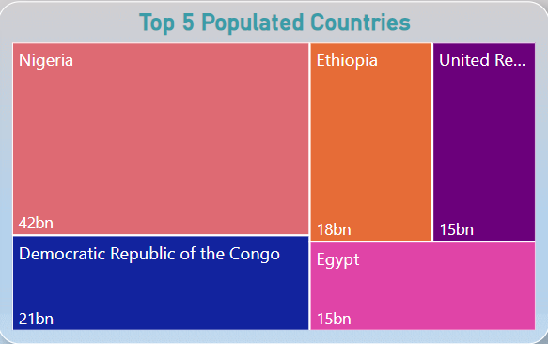
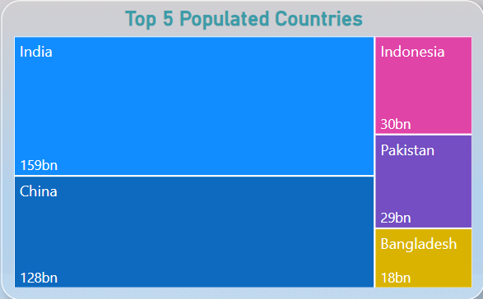
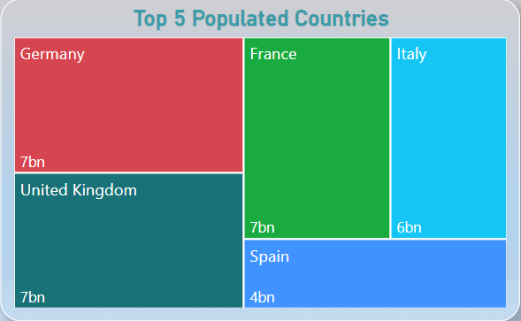
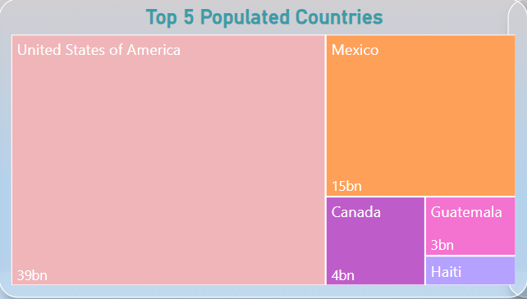
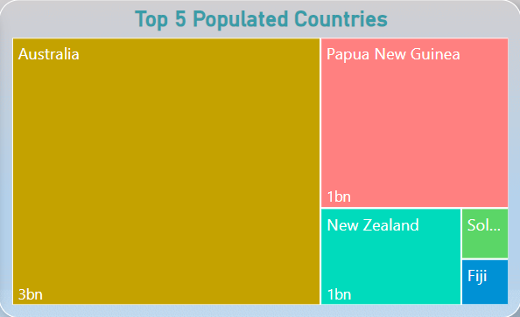
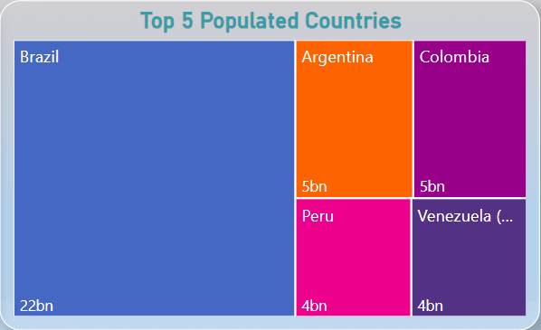
Which are the top 5 most populated countries region wise?
Africa
Asia
Europe
North America
Oceania
South America

Slide 15
RECOMMENDATIONS

Slide 16
To reduce population growth in Asia, key strategies include –
improving access to family planning, education (especially for women), and healthcare to lower infant mortality.
Encouraging urbanization, economic development, and social security can also help reduce birth rates.
Governments could promote smaller families through incentives and support later marriage and childbearing.
Additionally, promoting gender equality and workplace support for parents can further encourage smaller families, aiming to balance population control with better quality of life.

Slide 17
To increase population in Europe, key strategies include –
Offering financial incentives for families, improving paid parental leave, and providing affordable childcare and housing.
Policies to attract immigrants and support their integration, along with flexible work arrangements, can help boost population.
Encouraging work-life balance, promoting gender equality, and providing fertility treatments are also important. Additionally, improving access to healthcare and education on reproductive health, as well as creating job opportunities for young people, can encourage early family planning and support family growth.
There is no need to focus on increasing the population in Oceania, Africa and North America as it has experienced steady population growth over the years.

Slide 18
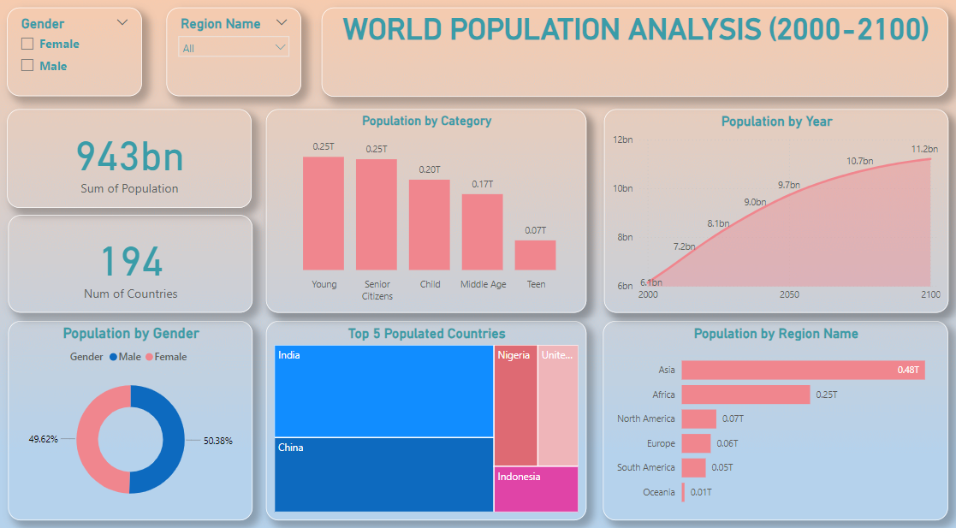

Slide 19
THANK YOU

